Slide 1
22. Elementary Graph Algorithms

Slide 2
22.1 Representations of Undirected Graphs
adjacency-matrix representation (dense)
adjacency-list representation (sparse)
symmetric !!
2E of nodes

Slide 3
Representations of Directed Graphs
Weighted graphs,
w: E → R
1
2
3
4
5
6

Slide 4
Graph Structure
G = (V, E): Graph = (Verteces, Edges)
Adj[u]: all the vertices v s.t. there is an (u, v) ∈ E
Adjacency lists
when the graph is sparse ( i.e., | E | << | V |² )
space: Θ(V + E)
Adjacency matrix
when the graph is dense ( i.e., | E | ~ | V |² )
or more efficient edge connection checking is necessary
space: Θ(V ²)
Either way is applicable to both directed and undirected graphs

Slide 5
More Comparison of Lists and Matrix
Adjacency lists
Space: Θ(V + E)
Time: to list all vertices adjacent to u: Θ(deg(u))
Time: to determine if (u, v) ∈ E: O(deg(u))
Adjacency matrix
Space: Θ(V²)
Time: to list all vertices adjacent to u: Θ(V)
Time: to determine if (u, v) ∈ E: Θ(1)

Slide 6
22.2 Breadth-First Search
BFS(G, s)
1 for each vertex u ∈ V(G) − {s}
2 do color[u] ← WHITE
3 d[u] ← ∞
4 π[u] ← NIL
5 color[s] ← GRAY
6 d[s] ← 0
7 π[s] ← NIL
8 Q ← {s}
9 while Q ≠ ∅
10 do u ← DEQUEUE(Q)
11 for each v ← Adj[u]
12 do if color[v] = WHITE
13 then color[v] ← GRAY
14 d[v] ← d[u] + 1
15 π[v] ← u
16 ENQUEUE(Q, v)
17 color[u] ← BLACK
π[u]: predecessor of u
O(V): line 9 – 10, 13 – 17
O(E): line 11 – 12
Complexity: O(V+E )

Slide 7
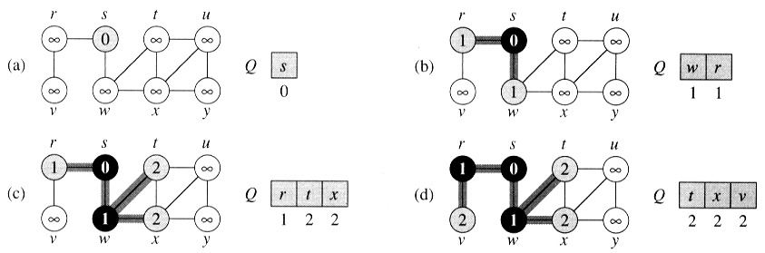
The Operation of BFS (on undirected graph)

Slide 8
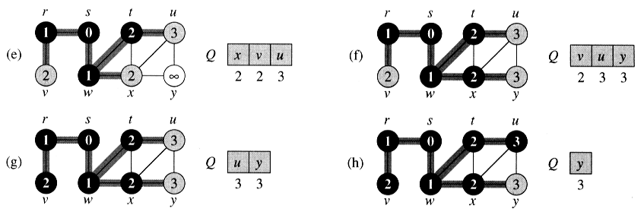
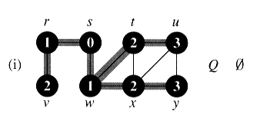
The Operation of BFS II (on undirected graph)

Slide 9
The Operation of BFS (on directed graph)
0
3
The queue Q consists of vertices with only 1 or 2 values
If 2, differ by 1 and all smallest are first
Each vertex gets a d value at most once, and values assigned to vertices are monotonically increasing over time
This code may not reach all vertices
s
1
f
c
2
1
a
g
2
i
3
e
3
b
h
3
0
1
s
1
a
c
2
2
e
g
3
3
b
3
h
i
f
3

Slide 10
BFS Creates Shortest paths
δ(s, v): shortest path from s to v
(δ(s, v) = ∞ if not reachable from s to v)
Lemma 22.1. Let G = (V, E) be a directed or undirected graph, and let s ∈ V be an arbitrary vertex. Then, for any edge (u, v) ∈ E, δ(s, v) ≤ δ(s, u) + 1.
u
s
v

Slide 11
Proof of Shortest Paths (I)
Lemma 22.2. Let G = (V, E) be a directed or undirected graph, and suppose that BFS is run on G from a given source s∈V. Then upon termination, for each vertex v∈V, the value d[v] computed by BFS satisfies d[v] ≥ δ(s, v).
Proof. (Induction on the number of times a vertex is placed in the queue)

Slide 12
Proof of Shortest Paths (II)
Lemma 22.3. Suppose that during the execution of BFS on a graph G = (V, E), the queue Q contains the vertices ⟨v₁, v₂, … v_{r}⟩, where v₁ is the head of Q and v_{r} is the tail. Then d[v_{r}] ≤ d[v₁]+1 and d[v_{i}] ≤ d[v_{i}+1] for i = 1, 2, …, r – 1.
Proof. (Induction on the number of queue operations)
i, i, i, i, i+1, i+1, i+1, i+1, i+1, i+1

Slide 13
Proof of Shortest Paths (III)
Corollary 22.4. Suppose vertices v_{i} and v_{j} are enqueued during the execution of BFS, and that v_{i} is enqueued before v_{j}.
Then d[v_{i}] ≤ d[v_{j}] at the time that v_{j} is enqueued.
Proof. Immediate form Lemma 22.3 and the property that each vertex receives a finite d value at most once during the course of BFS.
We can now prove that breadth-first search correctly finds shortest-path distances.

Slide 14
Theorem 22.5 (Correctness of BFS)
Let G = (V, E) be a directed or undirected graph, and suppose that BFS is run on G from a given source vertex s ∈ V. Then, during its execution, BFS discovers every vertex v ∈ V that is reachable from the source s, and upon termination, d[v] = δ(s, v) for all v ∈ V . Moreover, for any v ≠ s that is reachable from s, one of the shortest paths from s to v is the shortest path from s to π[v] followed by the edge (π[v], v).
Proof. By induction.

Slide 15
Breadth-First Trees
For a graph G = (V, E) with source s, we define the predecessor subgraph of G as G_{π} = (V_{π}, E_{π}) where V_{π} = {v∈V: π[v] ≠ NIL} ∪ {s}, and E_{π} = {(π[v], v): v ∈ V_{π} – {s}}. The edges in are called tree edges.
Lemma 22.6. When applied to a directed or undirected graph G = (V, E), procedure BFS constructs π so that the predecessor subgraph G_{π} = (V_{π}, E_{π}) is a breadth-first tree.

Slide 16
Print out Vertices on a Shortest Path
PRINT-PATH(G, s, v )
1 if v = s
2 then print s
3 else if π[v] = NIL
4 then print “no path from” s “to” v “exist”
5 else PRINT-PATH(G, s, π[v])
6 print v

Slide 17
22.3 Depth-First Search
DFS(G)
1 for each vertex u∈V[G]
2 do color[u] ← WHITE
3 π[u] ← NIL
4 time ← 0
5 for each vertex u∈V[G]
6 do if color[u] = WHITE
7 then DFS-VISIT(u)
DFS-VISIT(u)
1 color[u] = GRAY
2 d[u] ← time ← time +1
3 for each v ∈ Adj[u]
4 do if color[v] = WHITE
5 then π[v] ← u
6 DFS-VISIT(v)
7 color[u] = BLACK
8 f[u] ← time ← time + 1
a global variable
d[u] : discovery time
f[u]: finishing time
Complexity: O(V+E)

Slide 18
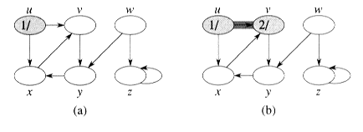
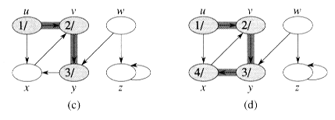
The Progress of DFS

Slide 19
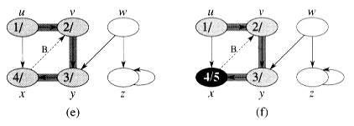
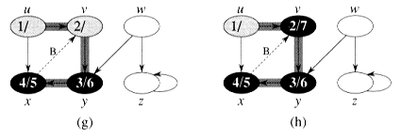
The Progress of DFS (II)

Slide 20
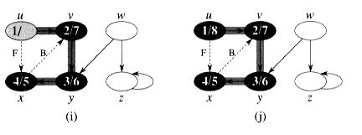
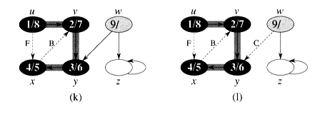
The progress of DFS (III)

Slide 21
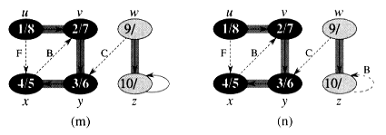
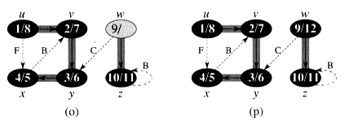
The Progress of DFS (IV)

Slide 22
Properties of Depth-First Search
Theorem 22.6. (Parenthesis theorem)
In any depth-first search of a (directed or undirected) graph G = (V, E) for any two vertices u and v, exactly one of the following three conditions holds:
the intervals [d(u), f(u)] and [d(v), f(v)] are entirely disjoint.
the interval [d(u), f(u)] is contained entirely within the interval [d(v), f(v)], and u is a descendant of v in the depth-first tree, or
the interval [d(v), f(v)] is contained entirely within the interval [d(u), f(u)], and v is a descendant of u in the depth-first tree.

Slide 23
Properties of Depth-First Search (II)
Corollary 22.8. (Nesting of descendants’ intervals)
Vertex v is a proper descendant of vertex u in the depth-first forest for a (directed or undirected) graph G if and only if d[u] < d[v] < f[v] < f[u].

Slide 24
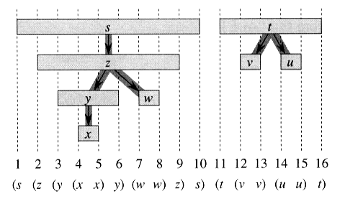
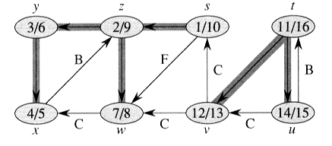
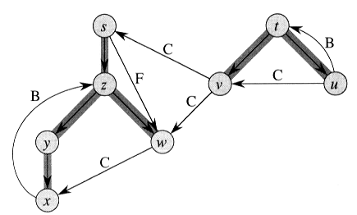
Property of DFS

Slide 25
Theorem 22.9 (white path theorem)
In a depth-first forest of a (directed or undirected) graph G = (V, E), vertex v is a descendant of vertex u if and only if at time d[u] that the search discover u, vertex v can be reached from u along a path consisting entirely of white vertices.
Classification of an edge (u, v): Color of v when (u, v) is explored
Tree edges WHITE d(u) < d(v) < f(v) < f(u)
Back edges GRAY d(v) < d(u) < f(u) < f(v)
Forward edges BLACK d(u) < d(v) < f(v) < f(u)
Cross edges BLACK d(v) < f(v) < d(u) < f(u)
Theorem 22.10. In a depth-first search of an undirected graph G, every edge of G is either a tree edge or a back edge.

Slide 26
22.4 Topological Sort
A topological sort of a Directed Acyclic Graph (DAG) G = (V, E) is a linear ordering of all its vertices such that if G contains an edge (u, v), then u appears before v in the ordering.
That is, can we make a total order from a partial order?
Below a → b, a → c belong to the partial ordering set!
b
a
c

Slide 27
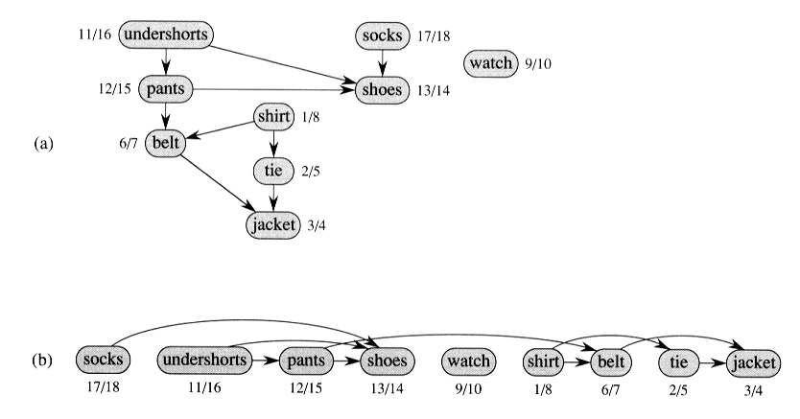
An Example of Topological Sort
shi
wa
un
so
ti
be
pa
ja
sho

Slide 28
Implementation of Topological Sort
TOPOLOGICAL-SORT(G)
1 Call DFS(G) to compute finishing time f[v] for each vertex v.
2 As each vertex is finished, insert it onto the front of a link list.
(f[u] is small ⇒ u will be near the end of the list!)
3 Return the link list of vertices.
Complexity: Θ(V + E)

Slide 29
Correctness of T-S()
Lemma 22.11. A directed graph G is acyclic if and only if a depth first search of G yields no back edge.
Theorem 22.12. TOPOLOGICAL-SORT(G) produces a topological sort of a directed acyclic graph G.
Proof:
Just need to show if (u, v) ∈ E, then f [v] < f [u]. When we explore (u, v), what are the colors of u and v?
If v is gray ⇒ v is an ancestor of u, (u, v) is a back edge
⇒ contradiction
If v is white (an tree edge): v becomes descendant of u
⇒ d[u] < d[v] < f [v] < f [u]
If v is black (an forward or cross edge):
v is already finished ⇒ f [v] < f [u]
}
u
v

Slide 30
22.5 Strongly Connected Components
STRONGLY-CONNECTED-COMPONENT(G)
1 call DFS(G) to compute finishing time f [u] for each vertex u
2 compute G^{T} (transpose of G)
3 call DFS(G^{T}), but in the main loop of DFS, consider the vertices in the order of decreasing f [u].
4 Output the vertices of each tree in the depth-first forest of step 3 as a separate strongly connected components.
Complexity: O(V + E)

Slide 31
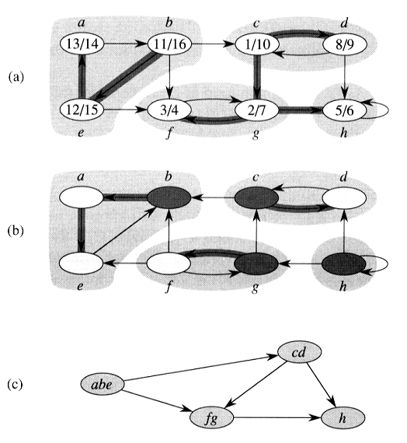
Note: G and G^{T}: will have the same strongly connected components!
1
2
Topological ordering of G:
abe → cd → f g → h
Topological ordering of G^{T}:
h → f g → cd → abe
3
4

Slide 32
Correctness of SCC()
Lemma 22.13. Let C and C’ be distinct strongly connected components in directed graph G = (V, E), let u, v ∈ C, let u’, v’ ∈ C’, and suppose that there is a path u ~> u’ in G. Then there cannot also be a path v’ ~> v in G.
C
u'
C’
u
×
v'
v

Slide 33
Correctness of SCC() (II)
Definition. (refers to the DFS on G)
d(U) = min_{u∈U} {d[u]} (earliest discovery time)
f(U) = max_{u∈U} {f[u]} (latest finishing time)
Lemma 22.14. Let C and C’ be distinct strongly connected components in directed graph G = (V, E). Suppose that there is an edge (u, v) ∈ E, where u ∈ C and v ∈ C’. Then f (C) > f (C’).
C
C’
u
v

Slide 34
Correctness of SCC() (III)
Corollary 22.15. Let C and C’ be distinct strongly connected components in directed graph G = (V, E). Suppose that there is an edge (u, v) ∈ E^{T}, where u ∈ C and v ∈ C’. Then f (C) < f (C’).
Corollary. Let C and C’ be distinct SCC’s in G = (V, E), and suppose f (C) > f (C’). Then there cannot be an edge from C to C’ in G^{T}
Theorem 22.16. Strongly-connected-component(G) correctly computes the strongly connected components of a directed graph G.

